Slide 1

Go Nuts
Stuck in a Lift Studios

Slide 2
What is it?
A networked multiplayer race game for 2-5 players.
PC standalone.
Approx. 5 minutes of desired playtime per round.

Slide 3
Who’s it for?
Males aged 10-15
*psychographic once we have one*

Slide 4
What do they do?
Core game loop:
Observe the level and potential paths through it.
Decide on the optimal path through the map.
Decide the method to achieve that route (ground movement/grapple/glide)
Execute.
Overall goal:
Obtain 3 nuts before anyone else.
Descend the hill
Grab a nut
Return to base

Slide 5
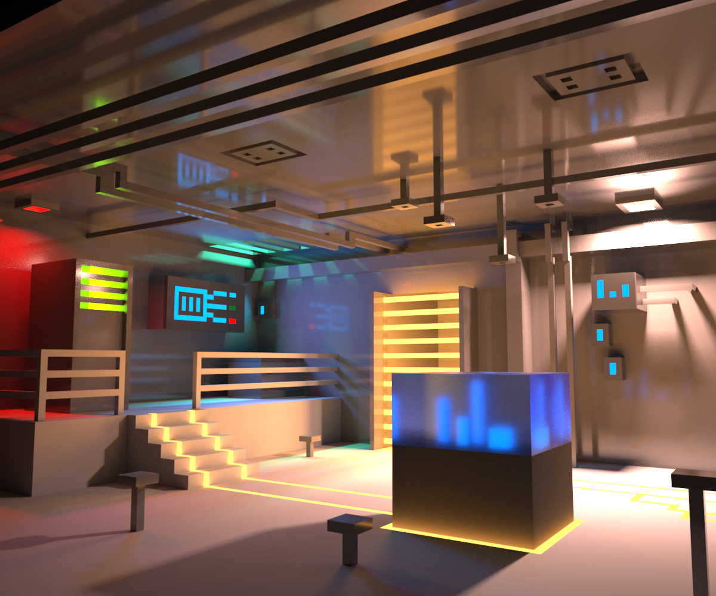
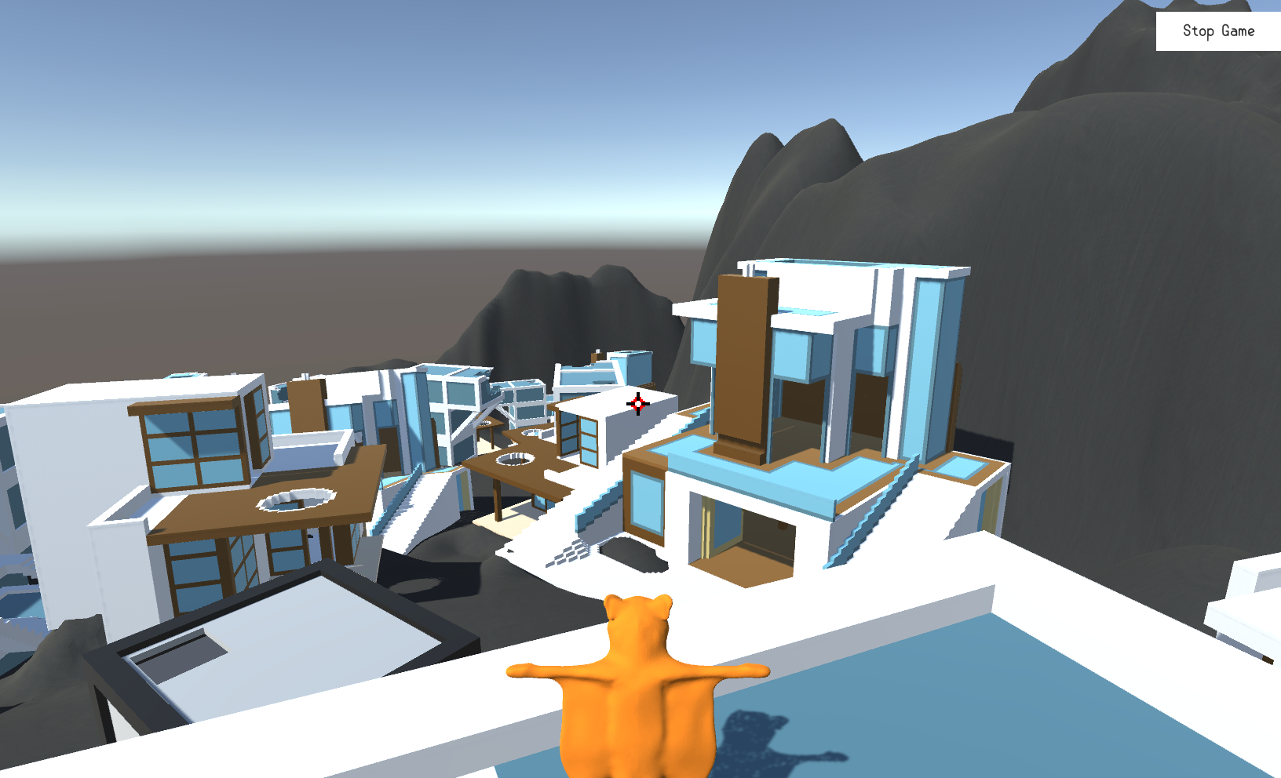


What does it look like?

Slide 6
The Gameplay
*Gameplay vids/gifs go here*

Slide 7
Feedback
"Gliding is pointless - too slow"
"Grapple needs cooldown"
"It's cool though"
"Camera placement is strange"
"Art style works"
"Allow jump at end of grapple"

Slide 8
Going forward
Level design changes/iterations.
Lighting/layout/guidance.
UI design and implementation
Further playtesting

